Slide 1
Database in the Cloud Part I
Dr. Leon Jololian

Slide 2
Contents
Creating a SQL Database using Azure Portal and CLI
Configuring DB, defining server, and setting up firewall
Opening the Database in Visual Studio 2015
Creating a new database tables
Editing data in tables
Using Java Code to access database

Slide 3

Visual Studio
Download Visual Studio 2017 Community Edition installer from:
https://www.visualstudio.com/downloads/

Slide 4
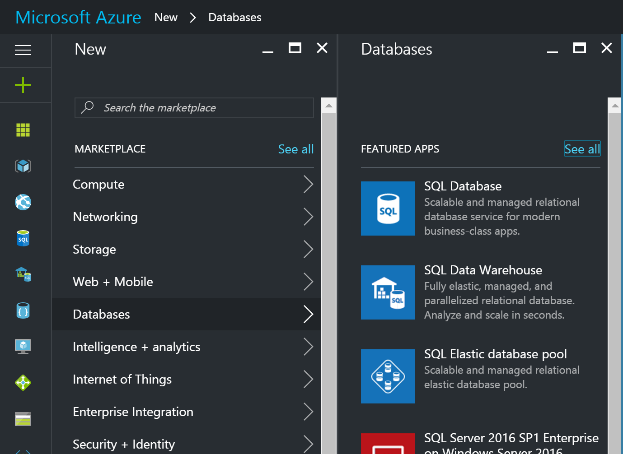
Sign in to the Azure portal
Navigate: + → Storage → SQL Database

Slide 5
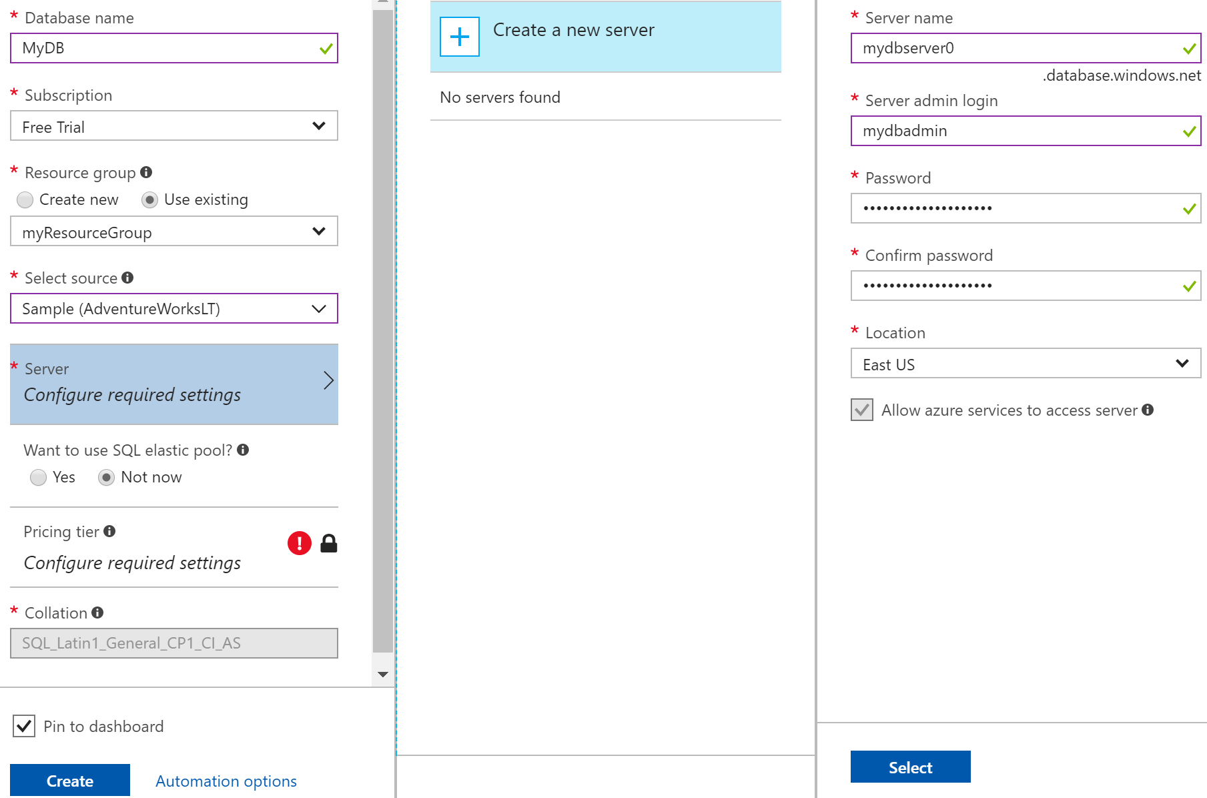
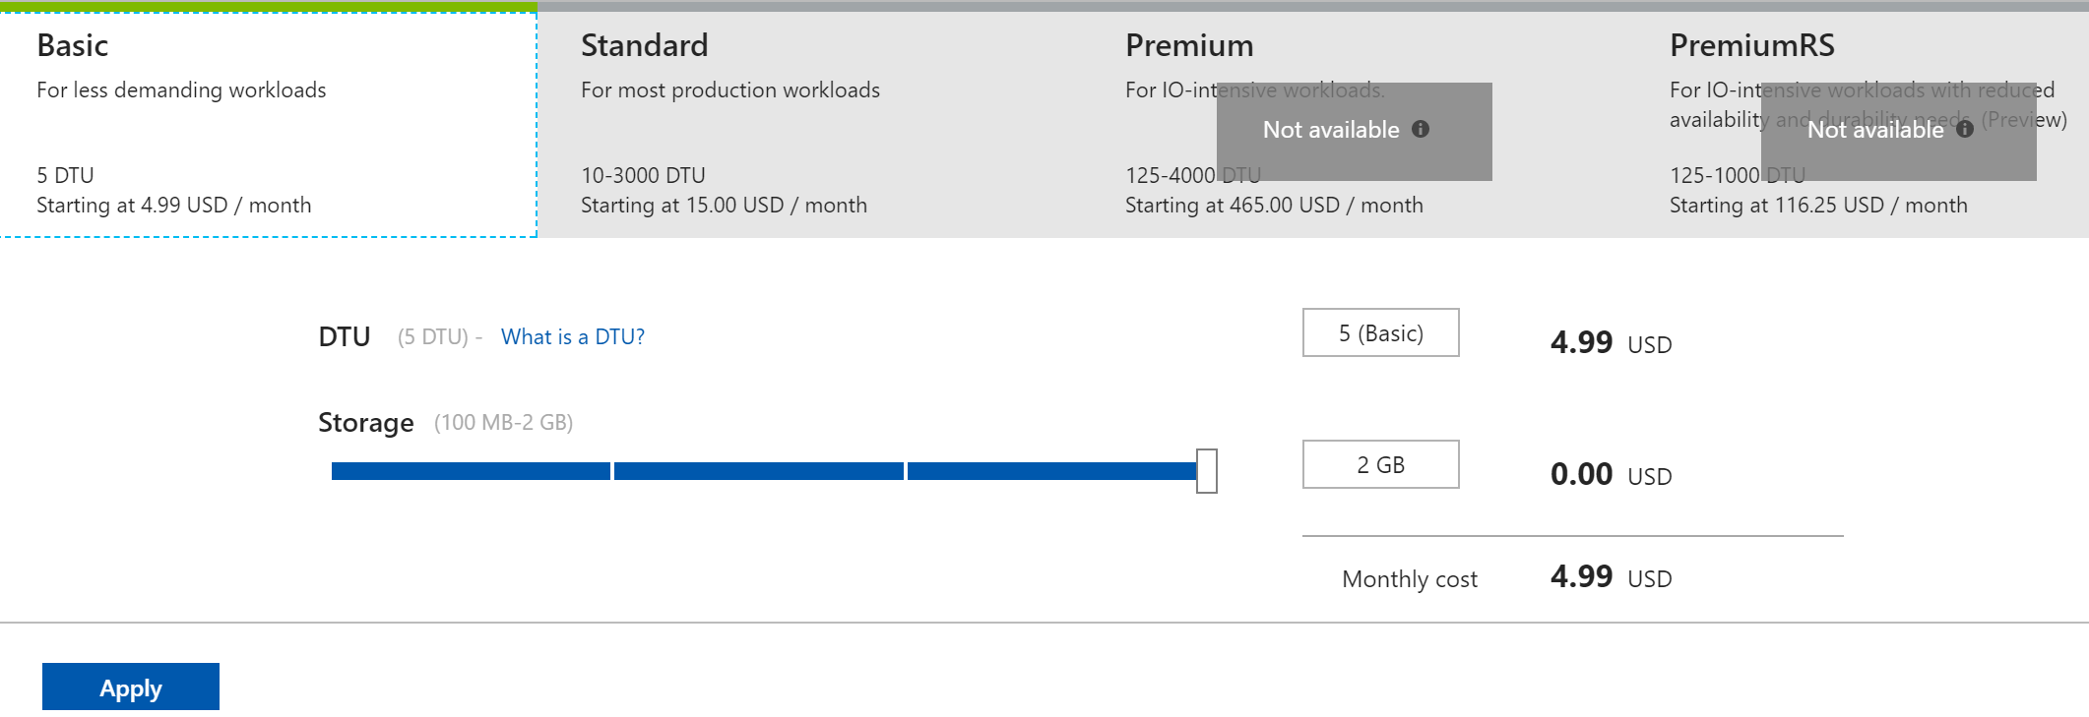
2
1
3
4
4

Slide 6
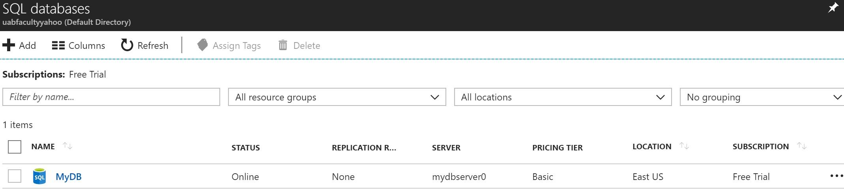
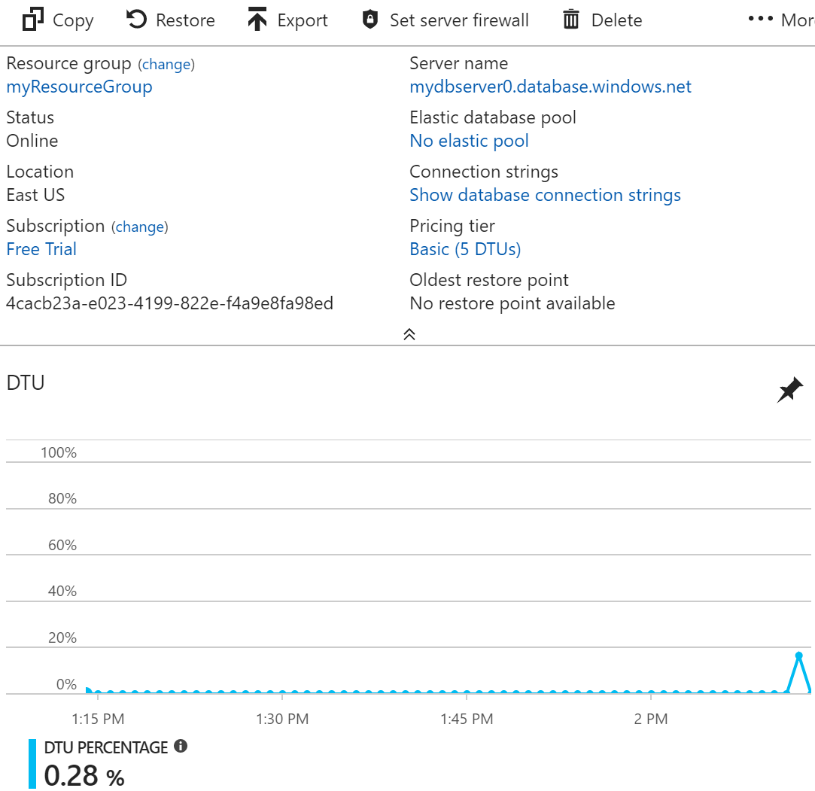
2
1
Server
Name
Connecting
String

Slide 7
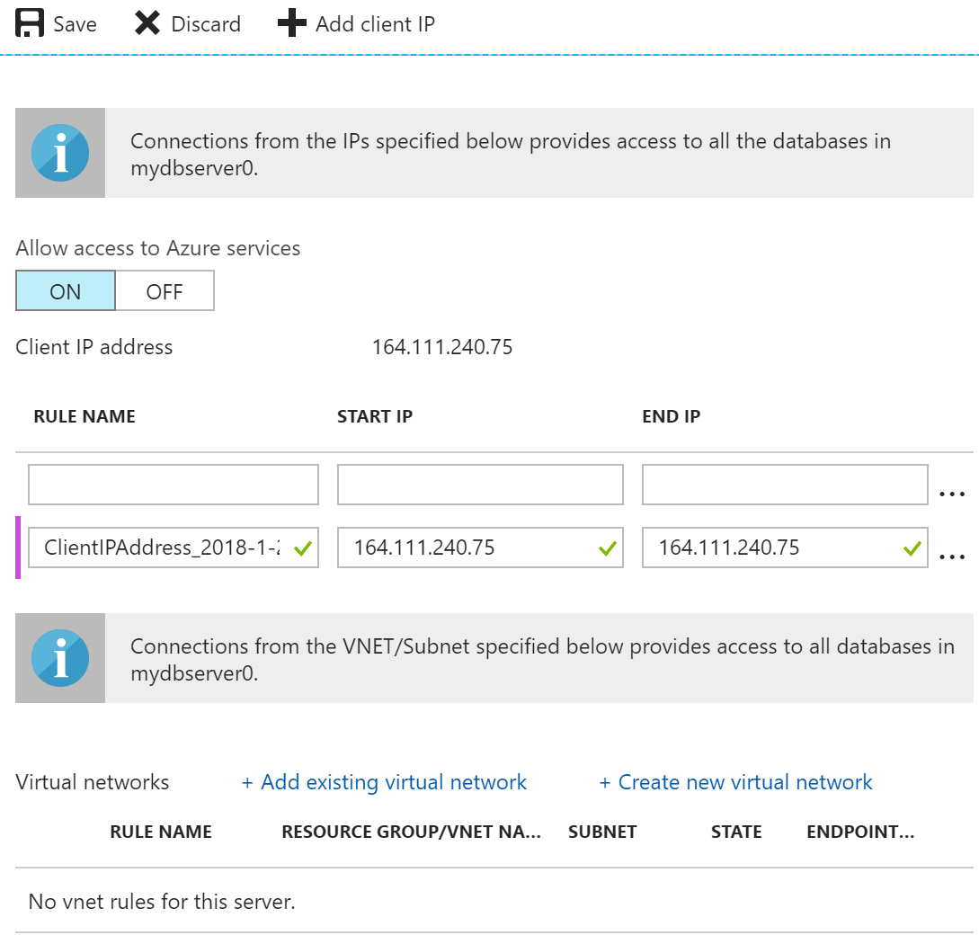
Setting up the Firewall
2
1
Open port 1433 for a single IP address

Slide 8
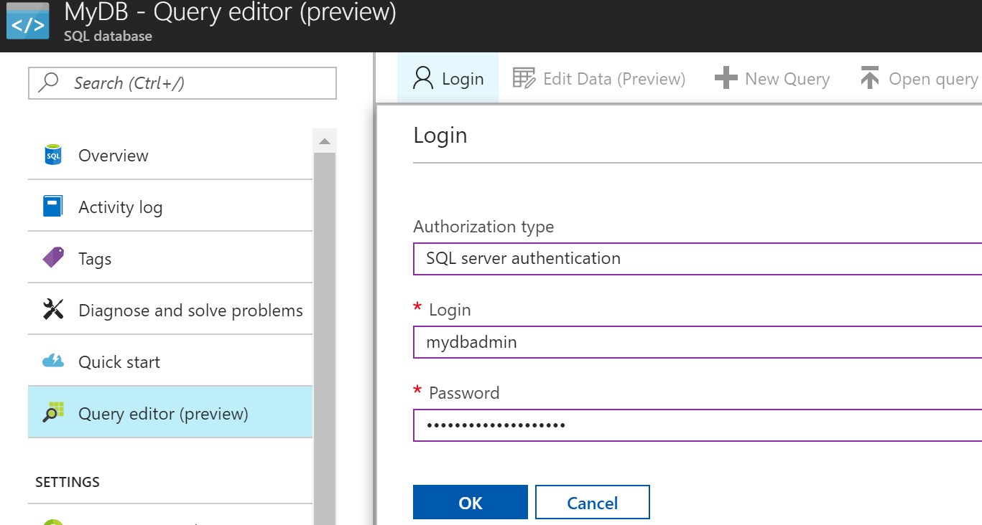
Login to explore DB
2
1

Slide 9
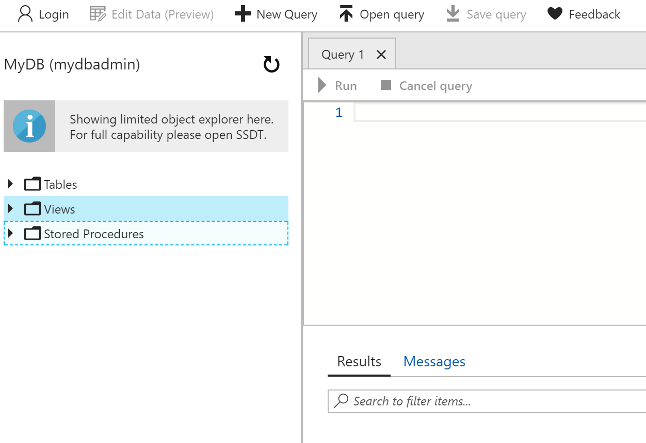

Slide 10
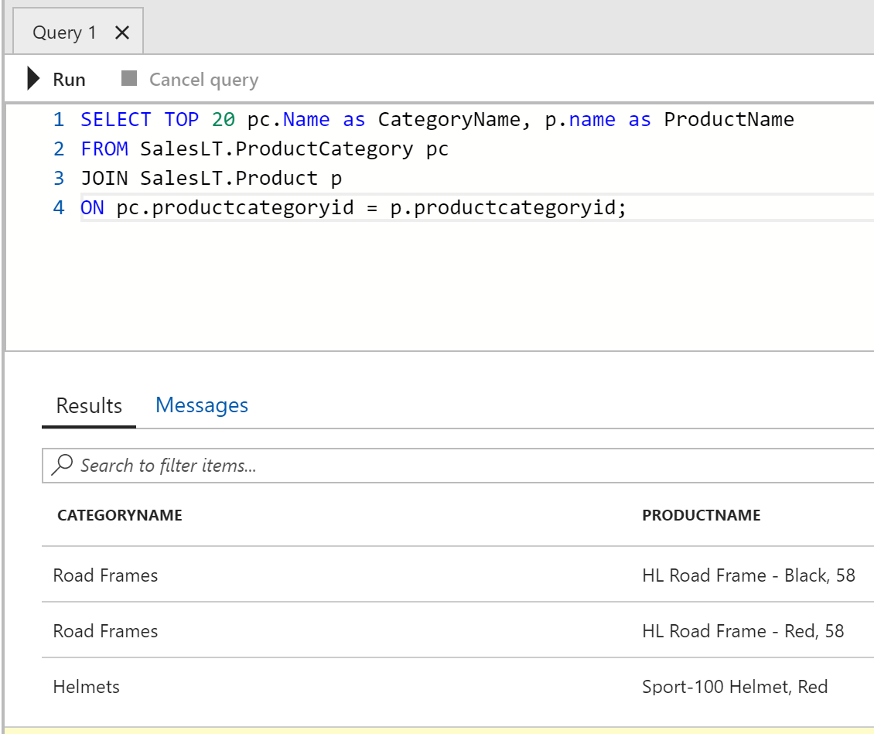
Running a Query
Query
Result

Slide 11
CREATE TABLE
Syntax:
CREATE TABLE table_name ( column1 datatype, column2 datatype, column3 datatype, .... );
Example:
CREATE TABLE Persons (
PersonID int,
LastName varchar(255),
FirstName varchar(255),
Address varchar(255),
City varchar(255)
);

Slide 12
The DROP TABLE statement is used to drop an existing table in a database:
DROP TABLE MyTable;
The TRUNCATE TABLE statement is used to delete the data inside a table, but not the table itself:
TRUNCATE TABLE table_name;
The INSERT INTO statement is used to insert new records in a table:
INSERT INTO table_name (column1, column2, column3, ...) VALUES (value1, value2, value3, ...);
INSERT INTO Persons (PersonID, LastName, FirstName, Address, City) VALUES (1, 'Doe', 'John', '123 Main Street', 'Birmingham');

Slide 13
The UPDATE statement is used to modify the existing records in a table:
UPDATE Persons
SET City = 'Mobile', Address= '50 Park Ave.'
WHERE PersonID = 1;
UPDATE Multiple Records:
UPDATE Persons
SET City = 'Atlanta'
WHERE PersonID < 10;
Updating all records:
UPDATE Persons
SET City = 'Athens'

Slide 14
The DELETE statement is used to delete existing records in a table:
DELETE FROM Persons
WHERE LastName = 'Doe’
Delete all records:
DELETE FROM table_name;

Slide 15
The SELECT Statement
The SELECT statement is used to select data from a database.
The data returned is stored in a result table, called the result-set.
SELECT column1, column2, ... FROM table_name;
To select all the fields available in the table:
SELECT * FROM Persons;
To select the "LastName" and "City" columns from the "Persons" table:
SELECT LastName, City FROM Persons;
To list the number of different (distinct) cities:
SELECT COUNT(DISTINCT City) FROM Persons;

Slide 16
The WHERE Clause
The WHERE clause is used to extract only those records that fulfill a specified condition:
SELECT column1, column2, ...
FROM table_name
WHERE condition;
Example:
SELECT * FROM Persons WHERE City='Mexico';
SQL requires single quotes around text values (most database systems will also allow double quotes).
Numeric fields should not be enclosed in quotes.

Slide 17
Operators in The WHERE Clause
Operator | Description
= | Equal
<> | Not equal. Note: In some versions of SQL this operator may be written as !=
> | Greater than
< | Less than
>= | Greater than or equal
<= | Less than or equal
BETWEEN | Between an inclusive range
LIKE | Search for a pattern
IN | To specify multiple possible values for a column

Slide 18
The AND, OR and NOT Operators
To select all fields from “Persons" where City is "Birmingham" AND FirstName is "John":
SELECT * FROM Persons WHERE City= 'Birmingham' AND FirstName= 'John’;
To select all fields from "Persons" where city is "Birmingham" OR "Atlanta":
SELECT * FROM Persons WHERE City='Birmingham' OR City= 'Atlanta';
To select all fields from "Persons" where City is NOT "Atlanta":
SELECT * FROM Persons
WHERE NOT City='Atlanta';
To select all fields with city NOT "Atlanta" and NOT "Birmingham":
SELECT * FROM Persons WHERE NOT City='Atlanta' AND NOT City='Birmingham';

Slide 19
ALTER TABLE
To add a column in a table:
ALTER TABLE table_name
ADD column_name datatype;
Example:
ALTER TABLE Persons ADD DateOfBirth date;
To delete a column in a table:
ALTER TABLE table_name
DROP COLUMN column_name;
Example:
ALTER TABLE Persons DROP COLUMN DateOfBirth;

Slide 20
Constraints
The NOT NULL constraint enforces a column to NOT accept NULL values:
CREATE TABLE Persons (
ID int NOT NULL,
LastName varchar(255) NOT NULL,
FirstName varchar(255) NOT NULL,
Age int
);

Slide 21
The UNIQUE Constraint
The UNIQUE constraint ensures that all values in a column are different:
CREATE TABLE Persons (
ID int NOT NULL UNIQUE,
LastName varchar(255) NOT NULL,
FirstName varchar(255),
Age int
);
To create a UNIQUE constraint on the "ID" column when the table is already created:
ALTER TABLE Persons
ADD UNIQUE (ID);

Slide 22
PRIMARY Key
The PRIMARY KEY constraint uniquely identifies each record in a database table.
Primary keys must contain UNIQUE values, and cannot contain NULL values:
CREATE TABLE Persons (
ID int NOT NULL PRIMARY KEY,
LastName varchar(255) NOT NULL,
FirstName varchar(255),
Age int
);
A PRIMARY KEY constraint automatically has a UNIQUE constraint.

Slide 23
We can have many UNIQUE constraints per table, but only one PRIMARY KEY constraint.
To create a PRIMARY KEY constraint on the "ID" column when the table is already created, use the following SQL:
ALTER TABLE Persons
ADD PRIMARY KEY (ID);
To drop a PRIMARY KEY constraint, use the following SQL:
ALTER TABLE Persons
DROP CONSTRAINT ID;

Slide 24
FOREIGN Key
A FOREIGN KEY is a key used to link two tables together.
A FOREIGN KEY is a field (or collection of fields) in one table that refers to the PRIMARY KEY in another table.
The "PersonID" column in the "Persons" table is the PRIMARY KEY in the "Persons" table.
The "PersonID" column in the "Orders" table is a FOREIGN KEY in the "Orders" table.
The FOREIGN KEY constraint is used to prevent actions that would destroy links between tables.
OrderID | OrderNumber | PersonID
1 | 77895 | 3
2 | 44678 | 3
3 | 22456 | 2
4 | 24562 | 1
PersonID | LastName | FirstName | Age
1 | Hansen | Ola | 30
2 | Svendson | Tove | 23
3 | Pettersen | Kari | 20

Slide 25
To create a FOREIGN KEY on the "PersonID" column when the "Orders" table is created:
CREATE TABLE Orders (
OrderID int NOT NULL PRIMARY KEY,
OrderNumber int NOT NULL,
PersonID int FOREIGN KEY REFERENCES Persons(PersonID)
);
To create a FOREIGN KEY constraint on the "PersonID" column when the "Orders" table is already created:
ALTER TABLE Orders
ADD FOREIGN KEY (PersonID) REFERENCES Persons(PersonID);
To drop a FOREIGN KEY constraint:
ALTER TABLE Orders
DROP CONSTRAINT PersonID;

Slide 26
Altering a Column from NULL to primary key:
UPDATE Orders SET OrderId = 0
where OrderId = null
ALTER TABLE Orders
ALTER COLUMN OrderId INTEGER NOT NULL
ALTER TABLE Orders
ADD PRIMARY KEY (OrderId);

Slide 27
CHECK Constraint
To create a CHECK constraint on the "Age" column when the "Persons" table is being created. This CHECK constraint ensures that age cannot be below 18 years:
CREATE TABLE Persons (
ID int NOT NULL,
LastName varchar(255) NOT NULL,
FirstName varchar(255),
Age int CHECK (Age>=18)
);
CHECK constraint on multiple columns:
CREATE TABLE Persons (
ID int NOT NULL,
LastName varchar(255) NOT NULL,
FirstName varchar(255),
Age int,
City varchar(255),
CONSTRAINT CHK_Person CHECK (Age>=18 AND City='Sandnes')
);

Slide 28
To create a CHECK constraint on the "Age" column when the table is already created:
ALTER TABLE Persons ADD CHECK (Age>=18);
To drop a CHECK constraint:
ALTER TABLE Persons
DROP CONSTRAINT CHK_PersonAge;

Slide 29
DEFAULT Constraint
To set a DEFAULT value for the "City" column when the "Persons" table is created:
CREATE TABLE Persons (
ID int NOT NULL,
LastName varchar(255) NOT NULL,
FirstName varchar(255),
Age int,
City varchar(255) DEFAULT 'Sandnes'
);
Default constraint using functions like GETDATE():
CREATE TABLE Orders (
ID int NOT NULL,
OrderNumber int NOT NULL,
OrderDate date DEFAULT GETDATE()
);

Slide 30
AUTO INCREMENT Field
Auto-increment allows a unique number to be generated automatically when a new record is inserted into a table.
Often this is the primary key field that we would like to be created automatically every time a new record is inserted.
CREATE TABLE Persons ( ID int IDENTITY(1,1) PRIMARY KEY, LastName varchar(255) NOT NULL, FirstName varchar(255), Age int );
To insert a new record into the "Persons" table, we will NOT have to specify a value for the "ID" column:
INSERT INTO Persons (FirstName, LastName)
VALUES ('Lars’, 'Monsen');

Slide 31
Views
A view is a virtual table based on the result-set of an SQL statement:
CREATE VIEW view_name AS SELECT column1, column2, ... FROM table_name WHERE condition;
Example,
CREATE VIEW [name and city] AS
SELECT LastName, City FROM Persons
To query the View:
SELECT * FROM [name and city];

Slide 32
Example
Create a table to store weather observation stations:
CREATE TABLE STATION (ID INTEGER PRIMARY KEY, CITY CHAR(20), STATE CHAR(2), LAT REAL, LONG REAL);
INSERT INTO STATION VALUES (13, 'Phoenix', 'AZ', 33, 112);
INSERT INTO STATION VALUES (44, 'Denver', 'CO', 40, 105);
INSERT INTO STATION VALUES (66, 'Caribou', 'ME', 47, 68);
ID | CITY | STATE | LAT | LON
13 | Phoenix | AZ | 33 | 112
44 | Denver | CO | 40 | 105
66 | Caribou | ME | 47 | 68

Slide 33
Query to select Northern stations (latitude > 39.7):
SELECT * FROM STATION
WHERE LAT > 39.7;
Query to select only ID, CITY, and STATE columns:
SELECT ID, CITY, STATE FROM STATION;
Create another table to store temperature and precipitation data:
CREATE TABLE STATS
(ID INTEGER REFERENCES STATION(ID),
MONTH INTEGER CHECK (MONTH BETWEEN 1 AND 12),
TEMP_F REAL CHECK (TEMP_F BETWEEN -80 AND 150),
RAIN_I REAL CHECK (RAIN_I BETWEEN 0 AND 100),
PRIMARY KEY (ID, MONTH));

Slide 34
Populate the table STATS with statistics for January and July:
INSERT INTO STATS VALUES (13, 1, 57.4, 0.31);
INSERT INTO STATS VALUES (13, 7, 91.7, 5.15);
INSERT INTO STATS VALUES (44, 1, 27.3, 0.18);
INSERT INTO STATS VALUES (44, 7, 74.8, 2.11);
INSERT INTO STATS VALUES (66, 1, 6.7, 2.10);
INSERT INTO STATS VALUES (66, 7, 65.8, 4.52);
Query to look at table STATS, picking up location information by joining with table STATION on the ID column:
SELECT * FROM STATION, STATS WHERE STATION.ID = STATS.ID;

Slide 35
Query to look at temperatures for July from table STATS, lowest temperatures first, picking up city name and latitude by joining with table STATION on the ID column:
SELECT LAT, CITY, TEMP_F
FROM STATS, STATION
WHERE MONTH = 7
AND STATS.ID = STATION.ID
ORDER BY TEMP_F;
Query to show MAX and MIN temperatures as well as average rainfall for each station:
SELECT * FROM STATION
WHERE 50 <
(SELECT AVG(TEMP_F) FROM STATS WHERE STATION.ID = STATS.ID);

Slide 36
Query (with subquery) to show stations with year-round average temperature above 50 degrees:
SELECT * FROM STATION WHERE 50 < (SELECT AVG(TEMP_F) FROM STATS WHERE STATION.ID = STATS.ID);

Slide 37
Create a view (derived table or persistent query) to convert Fahrenheit to Celsius and inches to centimeters:
CREATE VIEW METRIC_STATS (ID, MONTH, TEMP_C, RAIN_C) AS SELECT ID, MONTH, (TEMP_F - 32) * 5 /9, RAIN_I * 0.3937 FROM STATS;
Query to look at table STATS in a metric light (through the new view):
SELECT * FROM METRIC_STATS;
Another metric query restricted to January below-freezing (0 Celsius) data, sorted on rainfall:
SELECT * FROM METRIC_STATS
WHERE TEMP_C < 0 AND MONTH = 1
ORDER BY RAIN_C;

Slide 38
JDBC Driver
Microsoft JDBC Driver 6.0 for SQL Server, provides database connectivity through the standard JDBC application program interfaces (APIs) available in Java Platform.
Download sqljdbc_6.0.8112.100_enu.tar.gz from: https://www.microsoft.com/en-us/download/details.aspx?id=11774
Extract the sqljdbc_6.0 folder from the downloaded file.
Copy the file sqljdbc4.jar to your working directory.
Set the “classpath” environment variable in your CMD window:
set classpath=.; sqljdbc4.jar
Verify the value of the “classpath” variable:
echo %classpath% (you should see: .;sqljdbc42.jar )

Slide 39
Java code sample
The following sample code will demonstrate how to perform the following actions to a database:
Insert data into tables
Perform transactions and commit to update data
Query the database to return data
The code consist of:
A “main” function that serves as skeleton code. The only functionality it has is to connect to an existing database. You can compile and run.
Code for inserting data into database.
Code for retrieving data from database.

Slide 40
import java.sql.*;
import com.microsoft.sqlserver.jdbc.*;
public class SQLDatabaseTest {
public static void main(String[] args) {
String connectionString =
"jdbc:sqlserver://myserver0.database.windows.net:1433;"
+ "database=MyDB; " + "user=leon@myserver0;"
+ "password={Noel1234$}; " + "encrypt=true;"
+ "trustServerCertificate=false; "
+ "hostNameInCertificate=*.database.windows.net;"
+ "loginTimeout=30;";
Connection connection = null;
Statement statement = null;
ResultSet resultSet = null;
PreparedStatement prepsInsertPerson = null;
PreparedStatement prepsUpdateAge = null;

Slide 41
try {
connection = DriverManager.getConnection(connectionString);
// INSERT two rows into the table
// …
// TRANSACTION and commit for an UPDATE
// …
// SELECT rows from the table
// …
} catch (Exception e) { e.printStackTrace(); }
finally {
if (prepsInsertPerson != null) try { prepsInsertPerson.close(); } catch(Exception e) {}
if (prepsUpdateAge != null) try { prepsUpdateAge.close(); } catch(Exception e) {}
if (resultSet != null) try { resultSet.close(); } catch(Exception e) {}
if (statement != null) try { statement.close(); } catch(Exception e) {}
if (connection != null) try { connection.close(); } catch(Exception e) {}
}
} }

Slide 42
Insert Data into Database
// INSERT rows into the table
String insertSql = "INSERT INTO Person (
id, firstName, lastName, age) VALUES "
+ "(1,'Bill', 'Gates', 59), " + "(2,'Steve', 'Ballmer', 59);";
prepsInsertPerson = connection.prepareStatement(
insertSql,
Statement.RETURN_GENERATED_KEYS);
prepsInsertPerson.execute();
// Retrieve the generated key from the insert
resultSet = prepsInsertPerson.getGeneratedKeys();
// Iterate through the set of generated keys
while (resultSet.next()) {
System.out.println("Generated: " + resultSet.getString(1)); }

Slide 43
Retrieve and Update the Database
// AutoCommit false to execute a single transaction at a time
connection.setAutoCommit(false);
// Write the SQL Update instruction
String transactionSql = "UPDATE Person SET Person.age = Person.age + 1;";
prepsUpdateAge = connection.prepareStatement(transactionSql);
// Execute the statement.
prepsUpdateAge.executeUpdate();
//Commit the transaction.
connection.commit();
// Return the AutoCommit value to true.
connection.setAutoCommit(true);

Slide 44
SELECT Rows from the Table
// Create and execute a SELECT SQL statement.
String selectSql = "SELECT firstName, lastName, age FROM dbo.Person";
statement = connection.createStatement();
resultSet = statement.executeQuery(selectSql);
// Iterate through the result set and print the attributes.
while (resultSet.next()) {
System.out.println(resultSet.getString(2) + " " + resultSet.getString(3));
}

